Slide 1
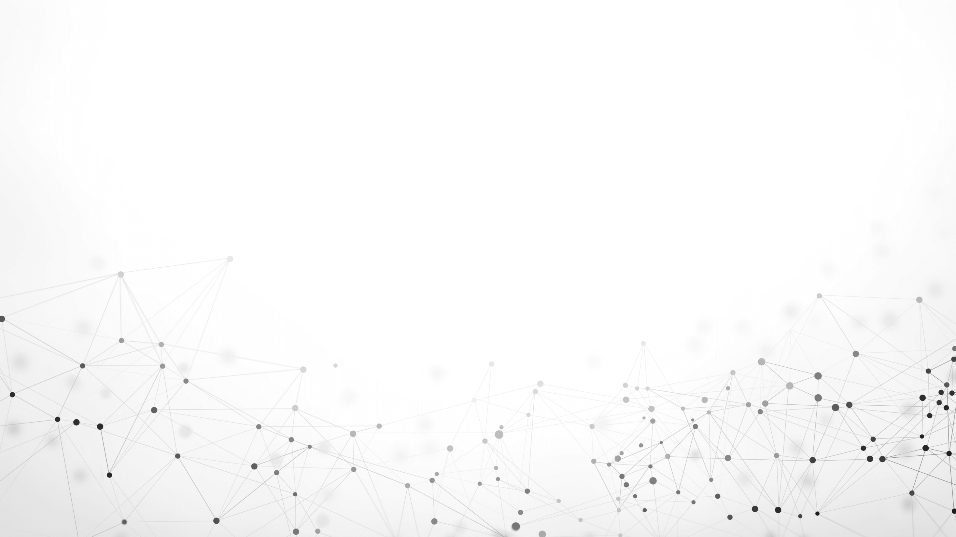
Generative Adversarial Networks
(GANs)

Slide 2
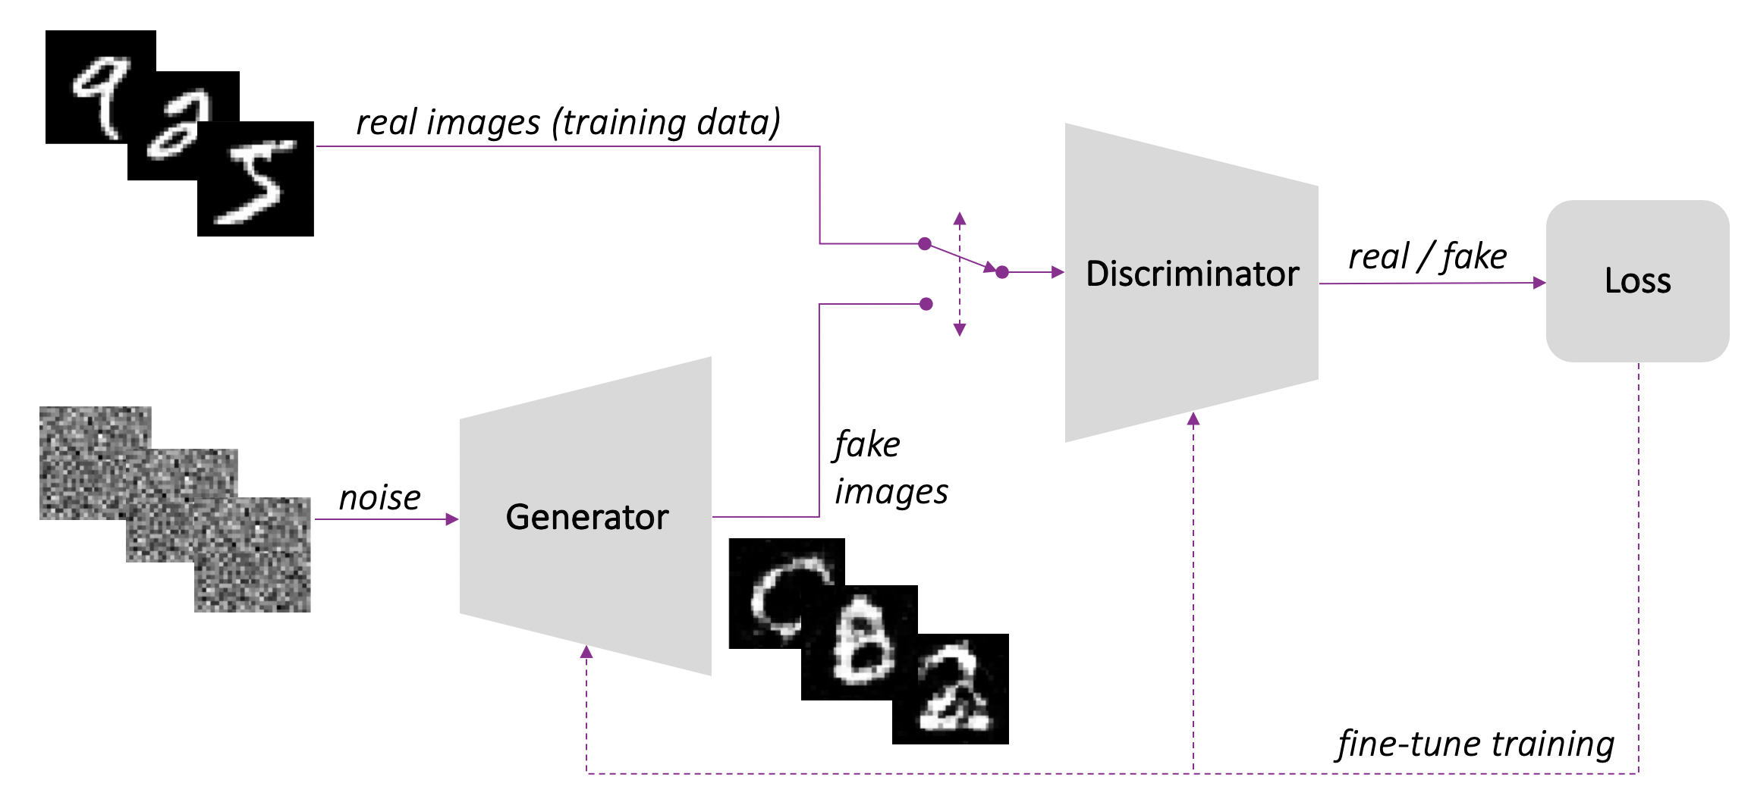
Architecture

Slide 3
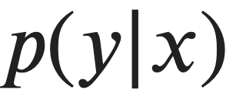
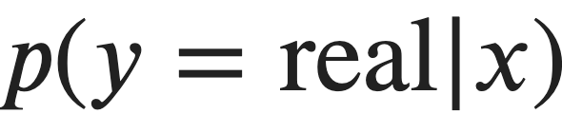
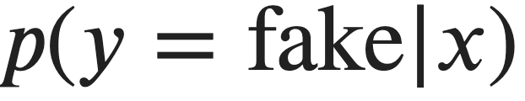
Model: Discriminator
Classifier: Classify by “Features of Images”
x: features of images, y: label (0/1)
Minimize the loss between the prediction and reality: BCE

Slide 4
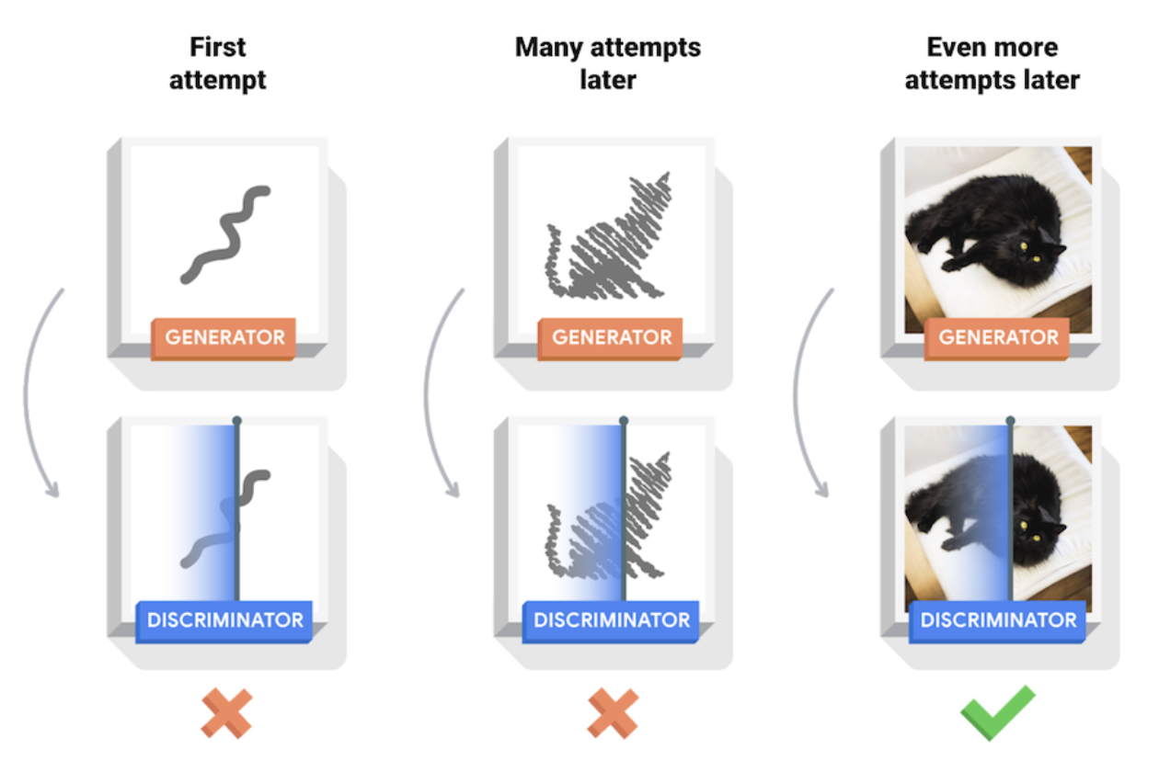
Model: Generator
The generator’s goal is to fool the discriminator
Learn how to make a realistic representation of some classes

Slide 5
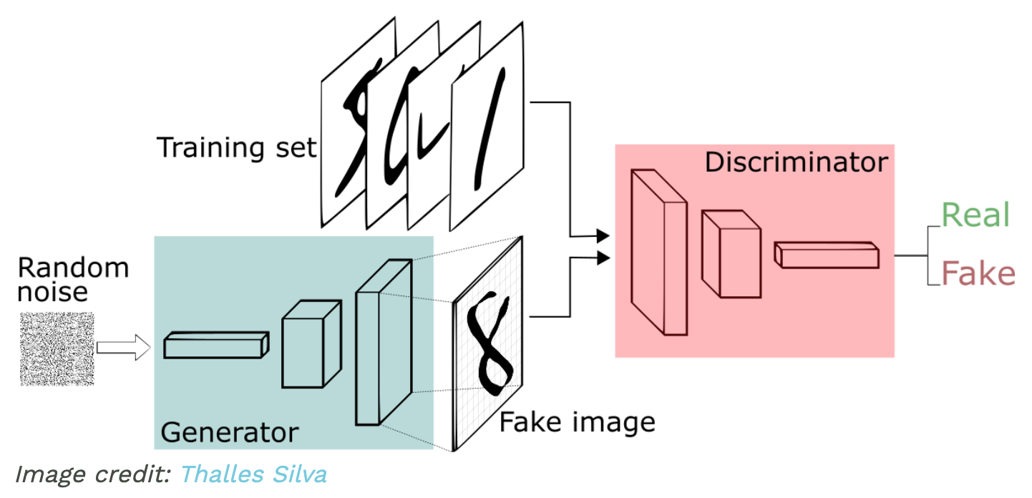
Model: Generator
Input: Noise + Class
Output: features
The noise vector 𝑧 has the important role of making sure the images generated from the same class 𝑦 don't all look the same—think of it as a random seed.

Slide 6
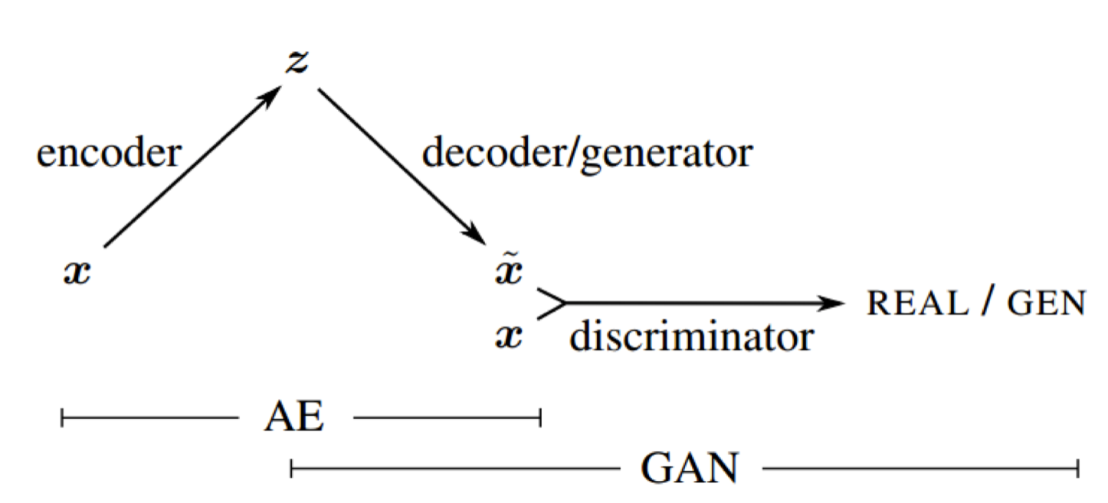
Types of Generative models: Variational Autoencoders (VAE)

Slide 7
Types of Generative models: Generative Adversarial Networks (GANs)
Generator learns to make fakes that look real
Discriminator learns to distinguish real from fake
They learn from the competition with each other
At the end, fakes look real

Slide 8
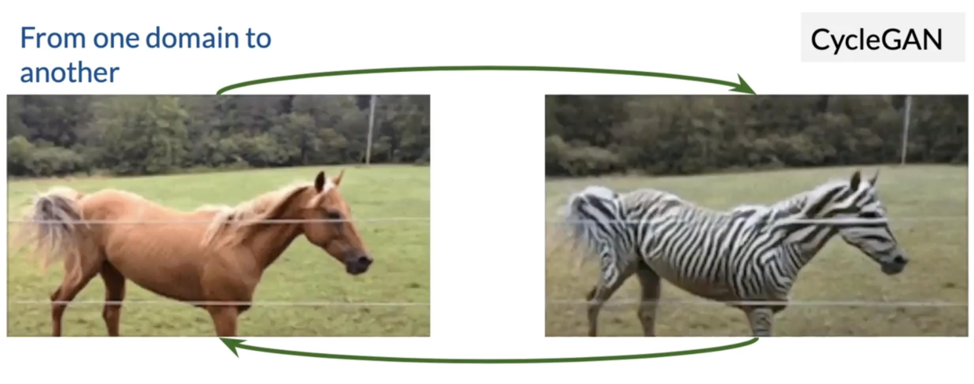
GANs of Image Translation: CycleGAN

Slide 9
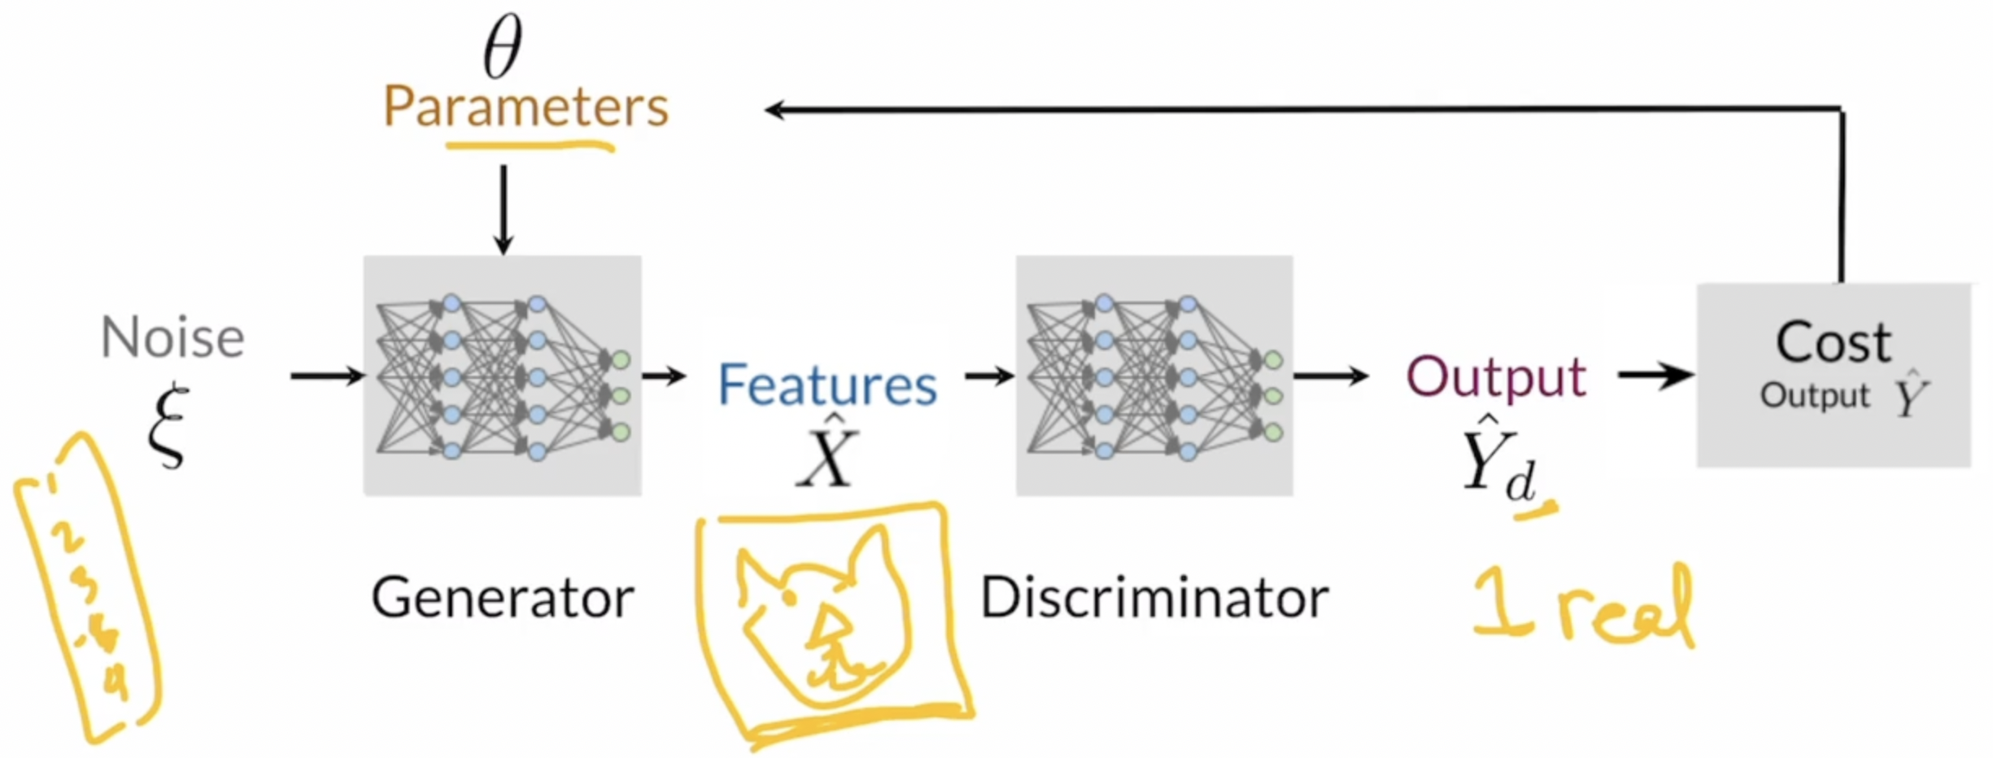
Generator and Discriminator

Slide 10
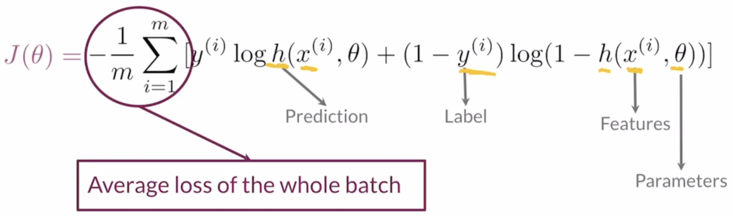
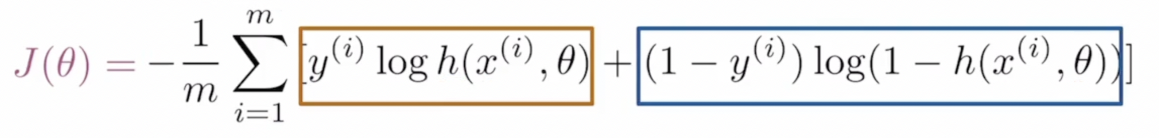
Binary Cross Entropy function (BCE function)

Slide 11
Binary Cross Entropy function (BCE function)
The BCE cost function has two parts (one relevant for each class)
Close to zero when the label and prediction are similar
Approaches infinity when the label and the prediction are different

Slide 12
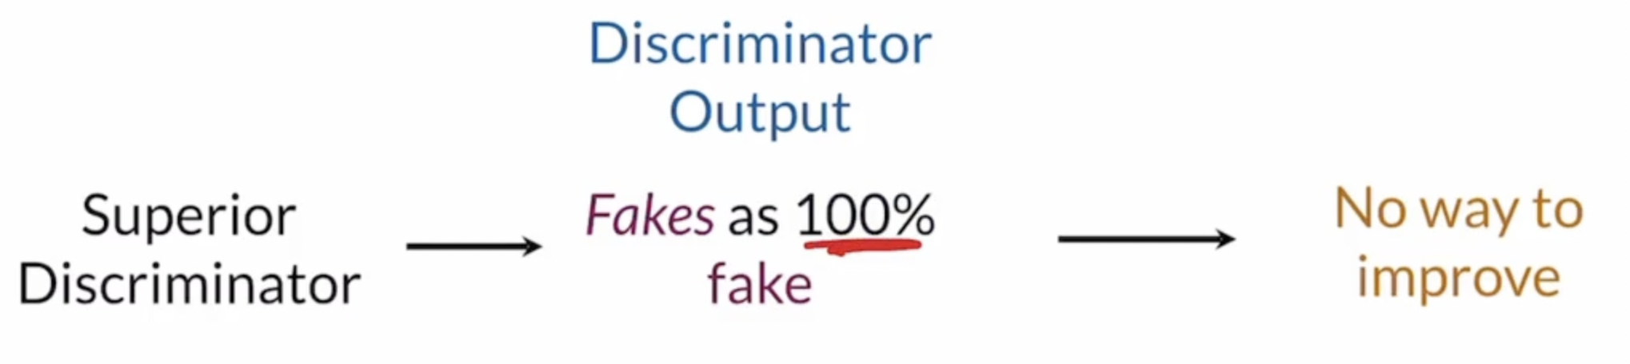
Training GANs model and its issue
GANs train in an alternating fashion
The two model should always be at similar “skill” level

Slide 13
DCGAN
Pre-trained Model Exploration

Slide 14
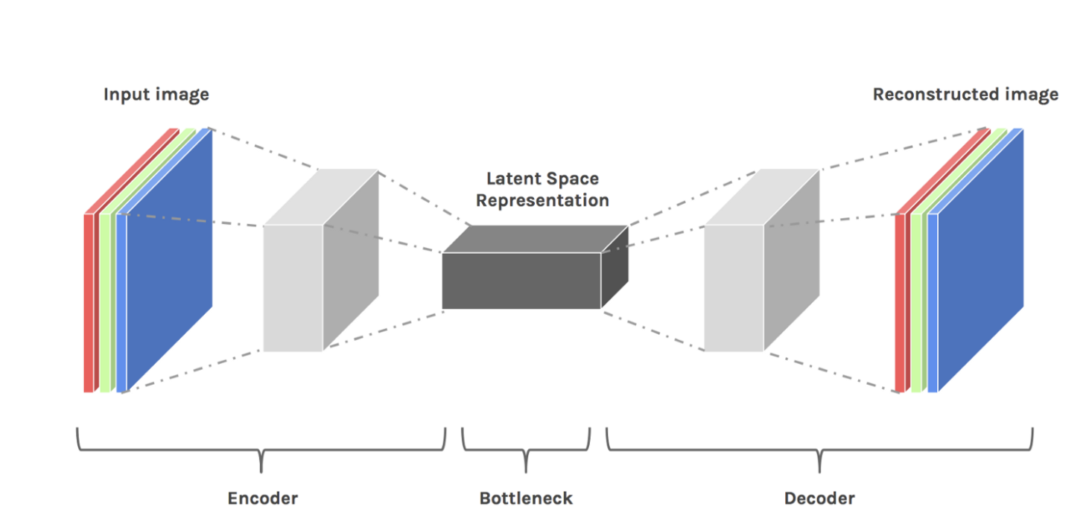
Latent Space
It must learn to store all relevant information and disregard the noise. This is the value of compression- it allows us to get rid of any extraneous information, and only focus on the most important features.

Slide 15
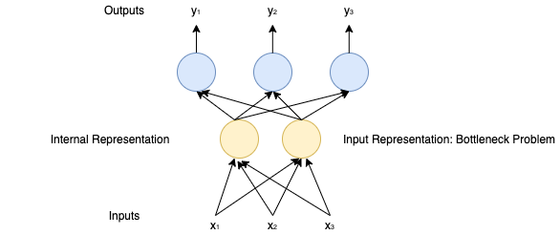
Latent Space: Bottleneck Problem in NLP

Slide 16
Latent Space
Convolutional Autoencoders (CAE)
A popular use for autoencoders is to apply them to images. The trick is to replace fully connected layers by convolutional layers. These, along with pooling layers, convert the input from wide and thin (let’s say 100 x 100 px with 3 channels — RGB) to narrow and thick.
This helps the network extract visual features from the images, and therefore obtain a much more accurate latent space representation. The reconstruction process uses upsampling and convolutions.

Slide 17



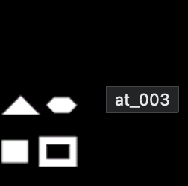
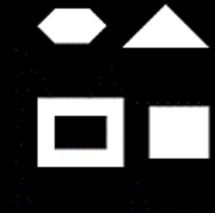
Affine Transformation

Slide 18
Datasets
The Stanford Dogs dataset contains images of 120 breeds of dogs from around the world
Number of categories: 120
Number of images: 20,580
Annotations: Class labels, Bounding boxes
The FFHQ Dataset (1024*1024, 10K)
Large-scale CelebFaces Attributes (CelebA) Dataset

Slide 19
Experiments
https://colab.research.google.com/github/theQuert/iganfun/blob/main/models/GANs_Dog_Images.ipynb

Slide 20
StyleGAN
Pre-trained Model Exploration

Slide 21
Style Mixing

Slide 22
Stochastic Variation

Slide 23
Separation of Global Effects from Stochasticity

